Slide 1

South Carolina Department of Education
Protecting Yourself During Testing
Christopher Seay
cseay@ed.sc.gov
803-734-8432
Protect Yourself During State Testing is licensed under a Creative Commons Attribution 4.0 International License.
Notes:
This is the test security training module for South Carolina’s statewide assessment system. This module is designed to help DTCs train school and district personnel in test security procedures and regulations.

Slide 2
State Testing Laws
South Carolina Department of Education
S.C. Code Ann. § 59-1-445 (2004) addresses violations of mandatory test security regulations and procedures, penalties, and investigations.
The following is an excerpt from this section:

Slide 3
State Testing Laws
South Carolina Department of Education
(1) It is unlawful for anyone knowingly and willfully to violate security procedures regulations promulgated by the State Board of Education for mandatory tests administered by or through the State Board of Education to students or educators, or knowingly and willfully to:
(a) Give examinees access to test questions prior to testing;
(b) Copy, reproduce, or use in any manner inconsistent with test security regulations all or any portion of any secure test booklet;
(c) Coach examinees during testing or alter or interfere with examinees’ responses in any way;
(d) Make answer keys available to examinees;
(e) Fail to follow security regulations for distribution and return of secure test [materials] as directed, or fail to account for all secure test materials before, during, and after testing;
(f) Participate in, direct, aid, counsel, assist in, encourage, or fail to report any of the acts prohibited in this section.

Slide 4
State Testing Laws
South Carolina Department of Education
Any person violating the provisions of this section or regulations issued hereunder Is guilty of a misdemeanor and upon conviction must be fined not more than one thousand dollars or be imprisoned for not more than ninety days, or both.
Upon conviction, the State Board of Education may suspend or revoke the administrative or teaching credentials, or both, of the person convicted.

Slide 5
State Testing Laws
South Carolina Department of Education
(2) The South Carolina Law Enforcement Division shall investigate allegations of violations of mandatory test security, either on its own initiative following receipt of allegations, or at the request of a school district or the State Department of Education. The South Carolina Law Enforcement Division shall furnish to the State Superintendent of Education a report of the findings of any investigation conducted pursuant to this section.

Slide 6
State Board Regulations
South Carolina Department of Education
S.C. Code Ann. § 59-1-447 (2004) requires the State Board of Education to establish detailed mandatory test security procedures by regulation.
The State Board of Education promulgated revised test security regulations that became effective June 27, 2003. These regulations, 24 S.C. Code Ann. Regs. 43-100 (Supp. 2006), are reprinted below:

Slide 7
State Board Regulations
South Carolina Department of Education
I. Tests administered by or through the State Board of Education shall include but are not limited to:
  A. The statewide tests, as defined in State Board of Education Regulation 43-262, including field tests and pilot tests;
  B. Examinations for admission to teacher education programs and teacher certification examinations;
  C. Examinations for admission to programs such as the gifted and talented program;
  D. High school equivalency tests.
II. As used in this regulation, “local school board” means the governing board of a public school district, a public charter school, as well as those of special school districts, special schools, and institutions that utilize tests administered by or through the State Board of Education.

Slide 8
State Board Regulations
South Carolina Department of Education
III. Each local school board must develop and adopt a district test security policy. The policy must provide for the security of materials for the entire period of time (before, during, or after testing) the materials are in the district and/or the schools within that district. The policy must address security for paper-based, computer-based, and customized assessments. This also applies to district-owned materials that are the same as those used in any state-operated testing or assessment program. Throughout the time testing materials are under the control of the school district, secure paper-based materials must be stored under lock and key when not in use for approved test administration activities.

Slide 9
State Board Regulations
South Carolina Department of Education
IV. Each District Superintendent and the administration from each of the special schools and institutions that utilize tests administered by or through the State Board of Education must designate annually one individual in each district for each mandated assessment who will be the sole individual in the district authorized to procure test instruments that are utilized in testing programs administered by or through the State Board of Education. The name of the designated individual must be provided to the South Carolina Department of Education (SCDE) in writing. When the testing program involves procurement of materials available commercially, the designated individual must be the sole individual in the district authorized to procure commercial test instruments which are utilized in testing programs administered by or through the State Board of Education.

Slide 10
State Board Regulations
South Carolina Department of Education
V. Individuals must adhere to all procedures specified in all operating manuals governing the mandated testing programs. Manuals are provided by or through the SCDE.
VI. A. The State Board of Education may invalidate test scores that reflect improbable gains and that cannot be satisfactorily explained through changes in student populations or instruction.
B. In cases where test results are invalidated because of a breach of security or action of the State Board of Education, any programmatic, evaluative, or certification criteria dependent upon the data will be deemed to not have been met.

Slide 11
State Board Regulations
South Carolina Department of Education
VII. Any individual(s) who knowingly engage(s) in any activity that results in the invalidation of scores derived from teacher certification examinations, the examinations for admission to teacher education programs, and/or the high school equivalency tests forfeits all opportunities to retake the test(s).
VIII. Any knowing involvement in the presentation of forged, counterfeit, or altered identification for the purpose of obtaining admission to a test administration site for any of the tests administered by or through the State Board of Education will be considered a breach of test security within the meaning of S.C. Code Ann. Section 59-1-445 (1990, 2004). Any individual(s) who knowingly cause(s) or allow(s) the presentation of forged, counterfeit, or altered identification for the purpose of obtaining admission to any test administration site specified in this paragraph forfeits all opportunities to retake the test(s).

Slide 12
State Board Regulations
South Carolina Department of Education
IX. Each of the following is considered a breach of professional ethics which may jeopardize the validity of the inferences made on the basis of test data and, as such, are viewed as security violations which could result in criminal prosecution and/or disciplinary action to an educator’s professional certificate.
A. Failing to administer tests on the test dates specified by the SCDE.
B. Failing to maintain an appropriate testing environment, free from undue distractions.
C. Failing to proctor the test to ensure that examinees are engaged in appropriate test-taking activities.
D. Providing examinees with access to test questions or specific test content prior to testing.
E. Providing examinees with access to answer keys prior to or during testing.

Slide 13
State Board Regulations
South Carolina Department of Education
F. Keeping, copying, reproducing, or using in any manner inconsistent with the instructions provided by or through the SCDE any test, test question, or specific test content.
G. Keeping, copying, or reproducing in any manner inconsistent with the instructions provided by or through the SCDE any portion of examinee responses to any item or any section of a secured test.
H. Coaching examinees, altering examinee responses, or interfering with examinee responses in any way prior to, during, or after testing. This includes hinting to examinees about the correctness of their responses.
I. Failing to follow instructions specified in the test manuals for the distribution, storage, or return of test materials or failing to account for test materials before, during, or after testing.

Slide 14
State Board Regulations
South Carolina Department of Education
J. Failing to follow all directions pertaining to the administration of a test as specified in the test manuals for that test. This section includes failure to clear the memory of calculators used on a test as directed in the test manual.
K. Allowing, participating in, assisting in, or encouraging any unauthorized access to test materials prior to, during, or after testing.
L. Disclosing the contents of any portion of secure materials or discussing the contents of secure tests with examinees, teachers, or other educators before, during, or after testing.
M. Leaving in view of examinees during test administration materials that are content or conceptually related to the subject areas being assessed.
N. Providing references or tools other than those specifically allowed in test manuals. Providing references or tools during test administration at times other than those specifically allowed in test manuals.

Slide 15
State Board Regulations
South Carolina Department of Education
O. Failing to provide accommodations and/or customized materials as specified in the student’s Individualized Education Program (IEP) or 504 plan. Providing accommodations and/or customized materials not included in the student’s IEP or 504 plan.
P. Excluding examinees or exempting from assessment students who should be assessed; however, this does not include students who opt out of the assessment.
Q. Failing to return test materials for all examinees.
R. Engaging in inappropriate test preparation practices that invalidate the test scores. These practices include activities that result in an increase in test scores without a simultaneous increase in the examinee’s real achievement or performance in the content area.
S. Revealing test scores or test performance to anyone not involved in the education of the examinee.

Slide 16
State Board Regulations
South Carolina Department of Education
T. Altering test scores in electronic records or files.
U. Failing to report a security breach.
X. The SCDE has the right and responsibility to observe test administration activities without prior notice in order to monitor adherence to test security. Examinees should be made aware that monitoring may occur.
XI. Any suspected violation of security must be reported to the South Carolina Law Enforcement Division.

Slide 17
State Board Regulations
South Carolina Department of Education
XII. If a security breach occurs in a district, or charter school, rendering test forms or test items unusable, funds equivalent to replacement costs may be withheld from the district or charter school by the SCDE at the discretion of the State Board of Education.
XIII. At the discretion of the State Board of Education, an educator may receive a public or private reprimand or the credential of an educator may be suspended or revoked based on evidence of violation of test security provisions.

Slide 18
Test Security – Protecting Yourself
South Carolina Department of Education
Signatures
Test Security Agreement Forms
Sign In / Sign Out Forms and Counting Items
Materials
Seating Charts
Environment
Seating Arrangements
Spacing of Students & Desks
Barriers
Electronics
Student & Adult
Only devices in room that are used for testing
Check and Check Again

Slide 19
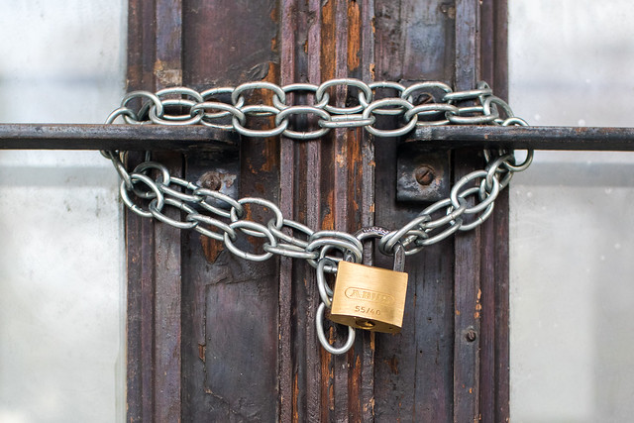
Protecting Testing Materials
South Carolina Department of Education
Ensure only the student and authorized staff have access
Who is in vault?
Who has keys to vault?
Who is in testing room?
Who has access to materials?
Who receives materials when they arrive at school?
Door of a bankrupt business locked with chain and padlock by Ivan Radic is licensed under CC BY 2.0

Slide 20
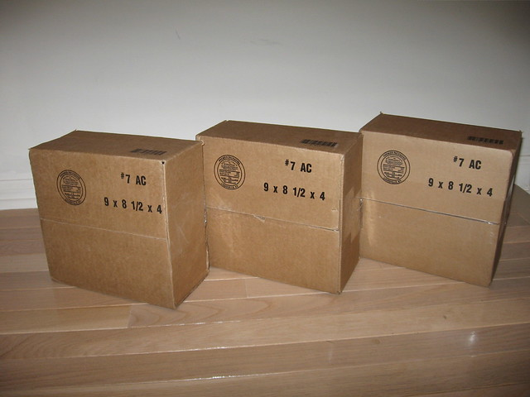
Protecting Testing Materials
South Carolina Department of Education
Ensure only the student and authorized staff have access
Maintain chain of custody from delivery and printing to shipping, using consistent protocols to collect and inventory all materials
Keep all packing slips
Check contents immediately when they arrive on campus
Double check contents of boxes before shipping them
Keep all Sign Out / Sign In Sheets
One TA responsible for materials per testing room
Three Boxes #3 by z287marc is licensed under CC BY 2.0

Slide 21
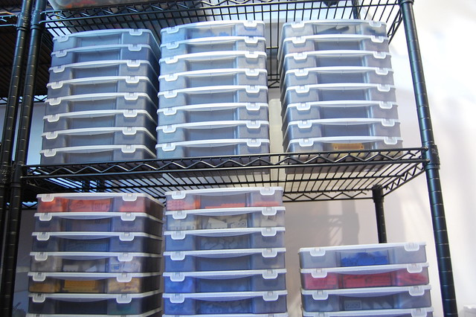
Protecting Testing Materials
South Carolina Department of Education
Ensure only the student and authorized staff have access
Maintain chain of custody from delivery and printing to shipping, using consistent protocols to collect and inventory all materials
All secure materials must be signed out and back in by both the STC and the TA. All items should be checked and counted.
Boxes by Lukas is licensed under CC BY 2.0
Having both the STC and the TA sign provides protection for both
DRC sheets only provide for one person to sign at this time so STC’s should initial above or below the column

Slide 22
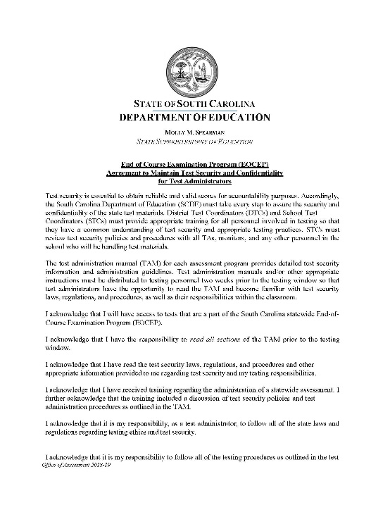
Protecting Testing Materials
South Carolina Department of Education
Ensure only the student and authorized staff have access
Maintain chain of custody from delivery and printing to shipping, using consistent protocols to collect and inventory all materials
All secure materials must be signed out and back in by both the STC and the TA. All items should be checked and counted.
Test Security Agreement Forms must be signed by all persons working with testing.
Do well in advance and after they have had a chance to read the TAM
Store in secure area
Provide electronic or hard copies when submitting TSV’s

Slide 23

Protecting Testing Materials
South Carolina Department of Education
Do not read or review test items unless instructed to do so in the Test Administration Manual (TAM)
_LBW7152 by U.S. Department of Education is licensed under CC BY 2.0

Slide 24

Protecting Testing Materials
South Carolina Department of Education
Do not discuss, disseminate, describe, or otherwise reveal anything about any tests to anyone
Talking by Harry Metcalf is licensed under CC BY 2.0

Slide 25
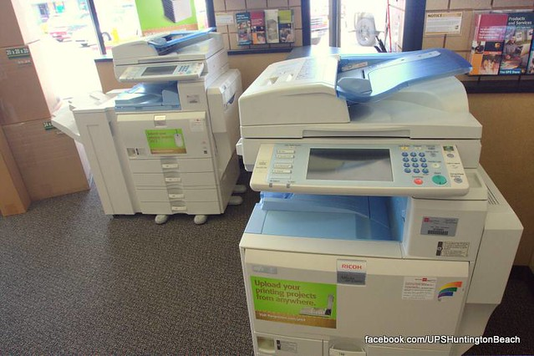
Protecting Testing Materials
South Carolina Department of Education
Do not keep, copy, or reproduce any portion of anything including anything in the TAM.
Copier by Andre W is licensed under CC BY 2.0

Slide 26

Protecting Testing Materials
South Carolina Department of Education
Test materials should never, ever, ever leave your sight.
Don’t leave on your desk in your classroom
Carry them with you or lock them behind two locks ( your door and your file cabinet)
If you carry them with you please don’t leave them at your new location
Stack of Papers by Phillip Wong is licensed under CC BY 2.0

Slide 27

Recommended Room Setup
South Carolina Department of Education
Recommendations for Testing Environment:
  Seat students in every other seat
  Arrange monitors back-to-back
  Seat students back-to-back
  Seat students in widely spaced rows or in every other row
  Dividers/Barriers between students seated closely together or with large screens
Back to School by Phil Roeder is licensed under CC BY 2.0

Slide 28
Cell Phones and Electronic Devices
South Carolina Department of Education
Cell phones and other electronic devices may not be used in the testing environment by students, TAs, or monitors.
  TA’s may not use a device to read testing directions
School Test Coordinators and Technology Support may use cell phones.
If a student or students’ testing device(s) experiences technical problems that prevent the student(s) from normal continuation of testing, the test administrator must alert the school test coordinator.

Slide 29
Closeout Procedures
South Carolina Department of Education
Test administrators must follow the closeout protocol detailed in the TAM for each student.
Test materials must be collected by the test administrator prior to the student receiving any other materials.
Test administrators may dismiss students or students may sit quietly or read books/complete activities not related to the assessed subject.
  Examples: Crossword puzzle after math; Sudoku puzzle after ELA
  Students may not use electronic devices for these activities

Slide 30
Test Integrity and Accommodations
South Carolina Department of Education
It is a violation of test security and integrity if a student does not receive their appropriate testing accommodations or if a student receives an accommodation they are not entitled to.
Students need to be familiar and comfortable with all necessary accommodation(s) BEFORE the assessment – practice tests and tutorials are a resource.
STCs should check testing accommodations multiple times as they prepare for testing (Materials, Rooms, Week Before, Day Before, etc)
Any unique/non-standard accommodations not included in the manuals for an assessment must be approved by SCDE prior to their use on statewide tests.
Notes:
Once testing begins, students must independently test. TAs/proctors may not assist students with the platform, accessibility features, or accommodations (UNLESS expressly allowed for that accommodation - example: human scribe)

Slide 31
Conducting An Investigation
South Carolina Department of Education
Collection of Supporting Documents
  Written statements from all adults involved
  Who, What, When, Where, Why, How
    Each person identified by assessment role and title.
    The affidavit needs to be signed and the name printed below signature.
    The statement must be dated.

Slide 32
Conducting An Investigation
South Carolina Department of Education
  Collect summaries of interviews with students if indicated
  IEP Team Minutes: needed for TSV packet
    Valid or Invalid
    If declared invalid, how invalidation was handled
      Consult test manual for invalidation directions
Write a DTC summary
  Use Assessment Role Titles
  Do not begin with a student name

Slide 33
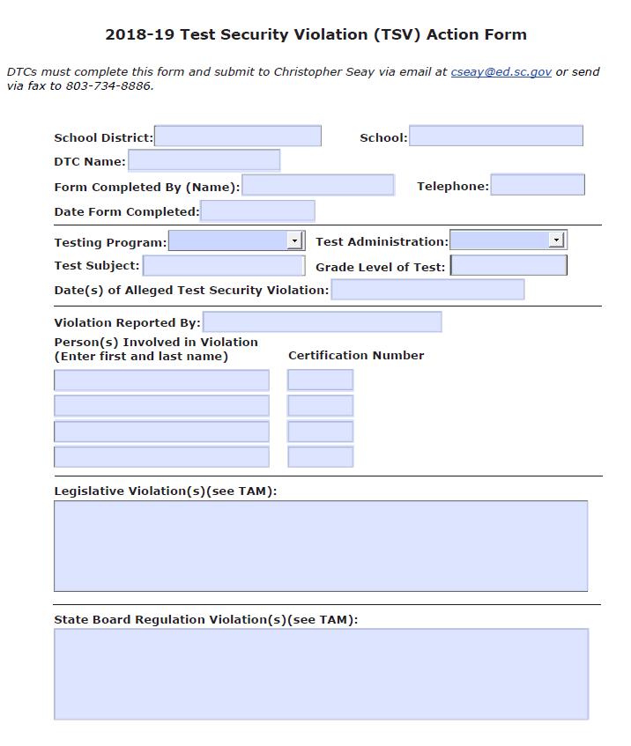
Preparing a TSV Form
South Carolina Department of Education

Slide 34
Preparing a TSV Form
South Carolina Department of Education
DTCS must complete the TSV form
Phone number must be the DTC phone number
Certification numbers are required
  Monitors and data clerks don’t have certification numbers. The supervisor may or may not be listed as a person involved in the violation but should be responsible and may need to give an affidavit.
  Use your judgment and/or call me.
Legislative Violation box is frequently blank
There may be more than one State Board Regulation Violation for a case

Slide 35


Test Security - Questions
South Carolina Department of Education

